Slide 1


Slide 2


Slide 3

Notes:
image source: "https://unsplash.com/photos/some-spices-and-dish-is-ready-PA-Xo2eF1cs"

Slide 4

Notes:
image source: "https://unsplash.com/photos/man-and-woman-standing-in-front-of-table-n4ymhyyFY7A"

Slide 5
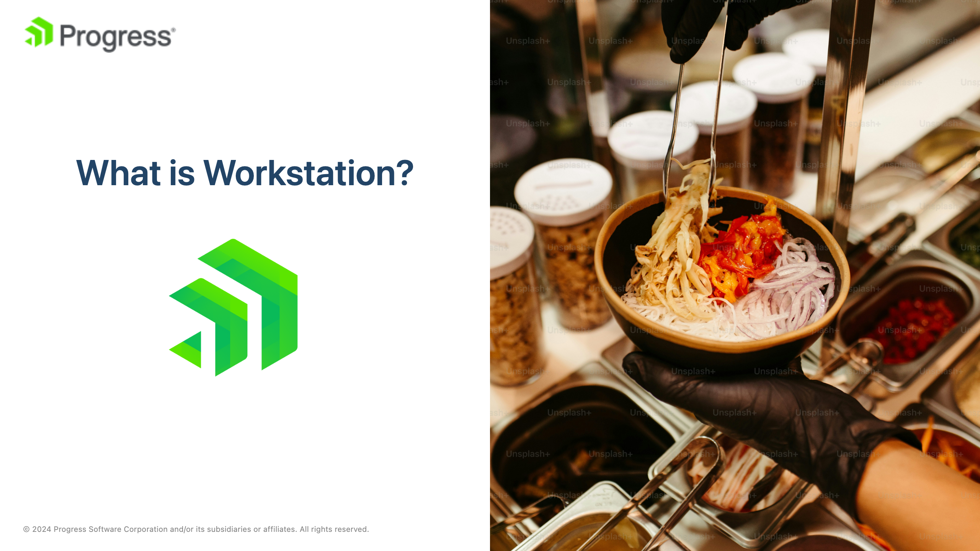
Notes:
image source: "https://unsplash.com/photos/a-person-holding-a-bowl-of-food-in-their-hand-6qQkzyz_FTI"

Slide 6

Notes:
image source: "https://unsplash.com/photos/person-writing-bucket-list-on-book-RLw-UC03Gwc"

Slide 7
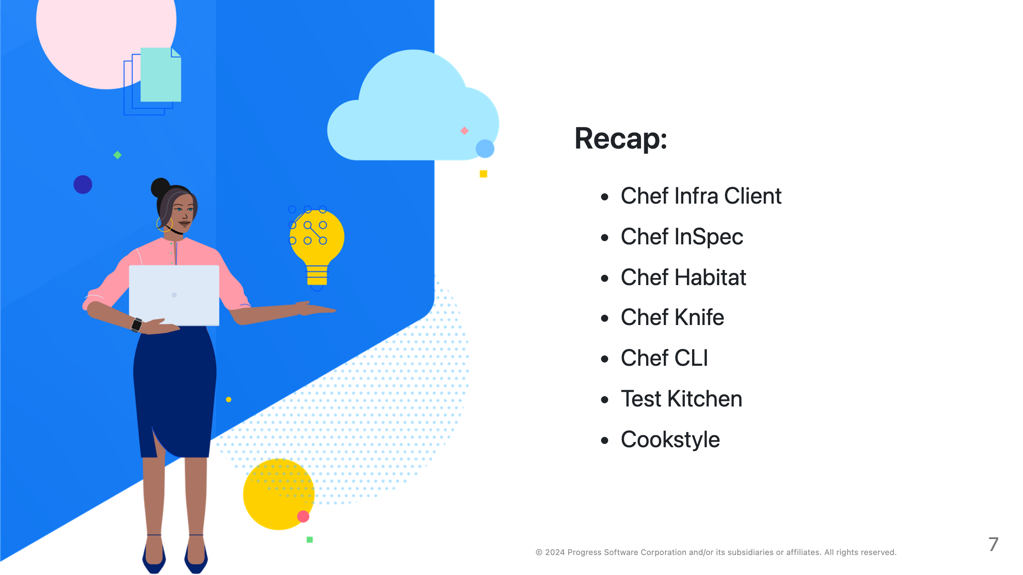

Slide 8


Slide 9

Notes:
image source: "https://unsplash.com/photos/text-Mfjq1hi-lVg"

Slide 10
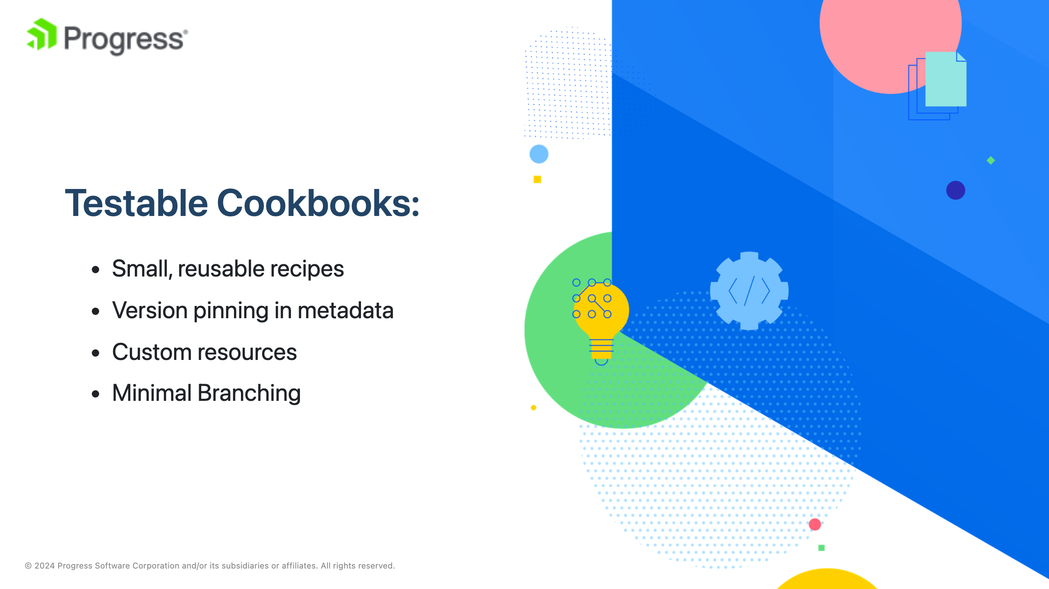
Notes:
Speaking Notes: Emphasize modular code, using resources effectively, metadata to manage dependencies.

Slide 11
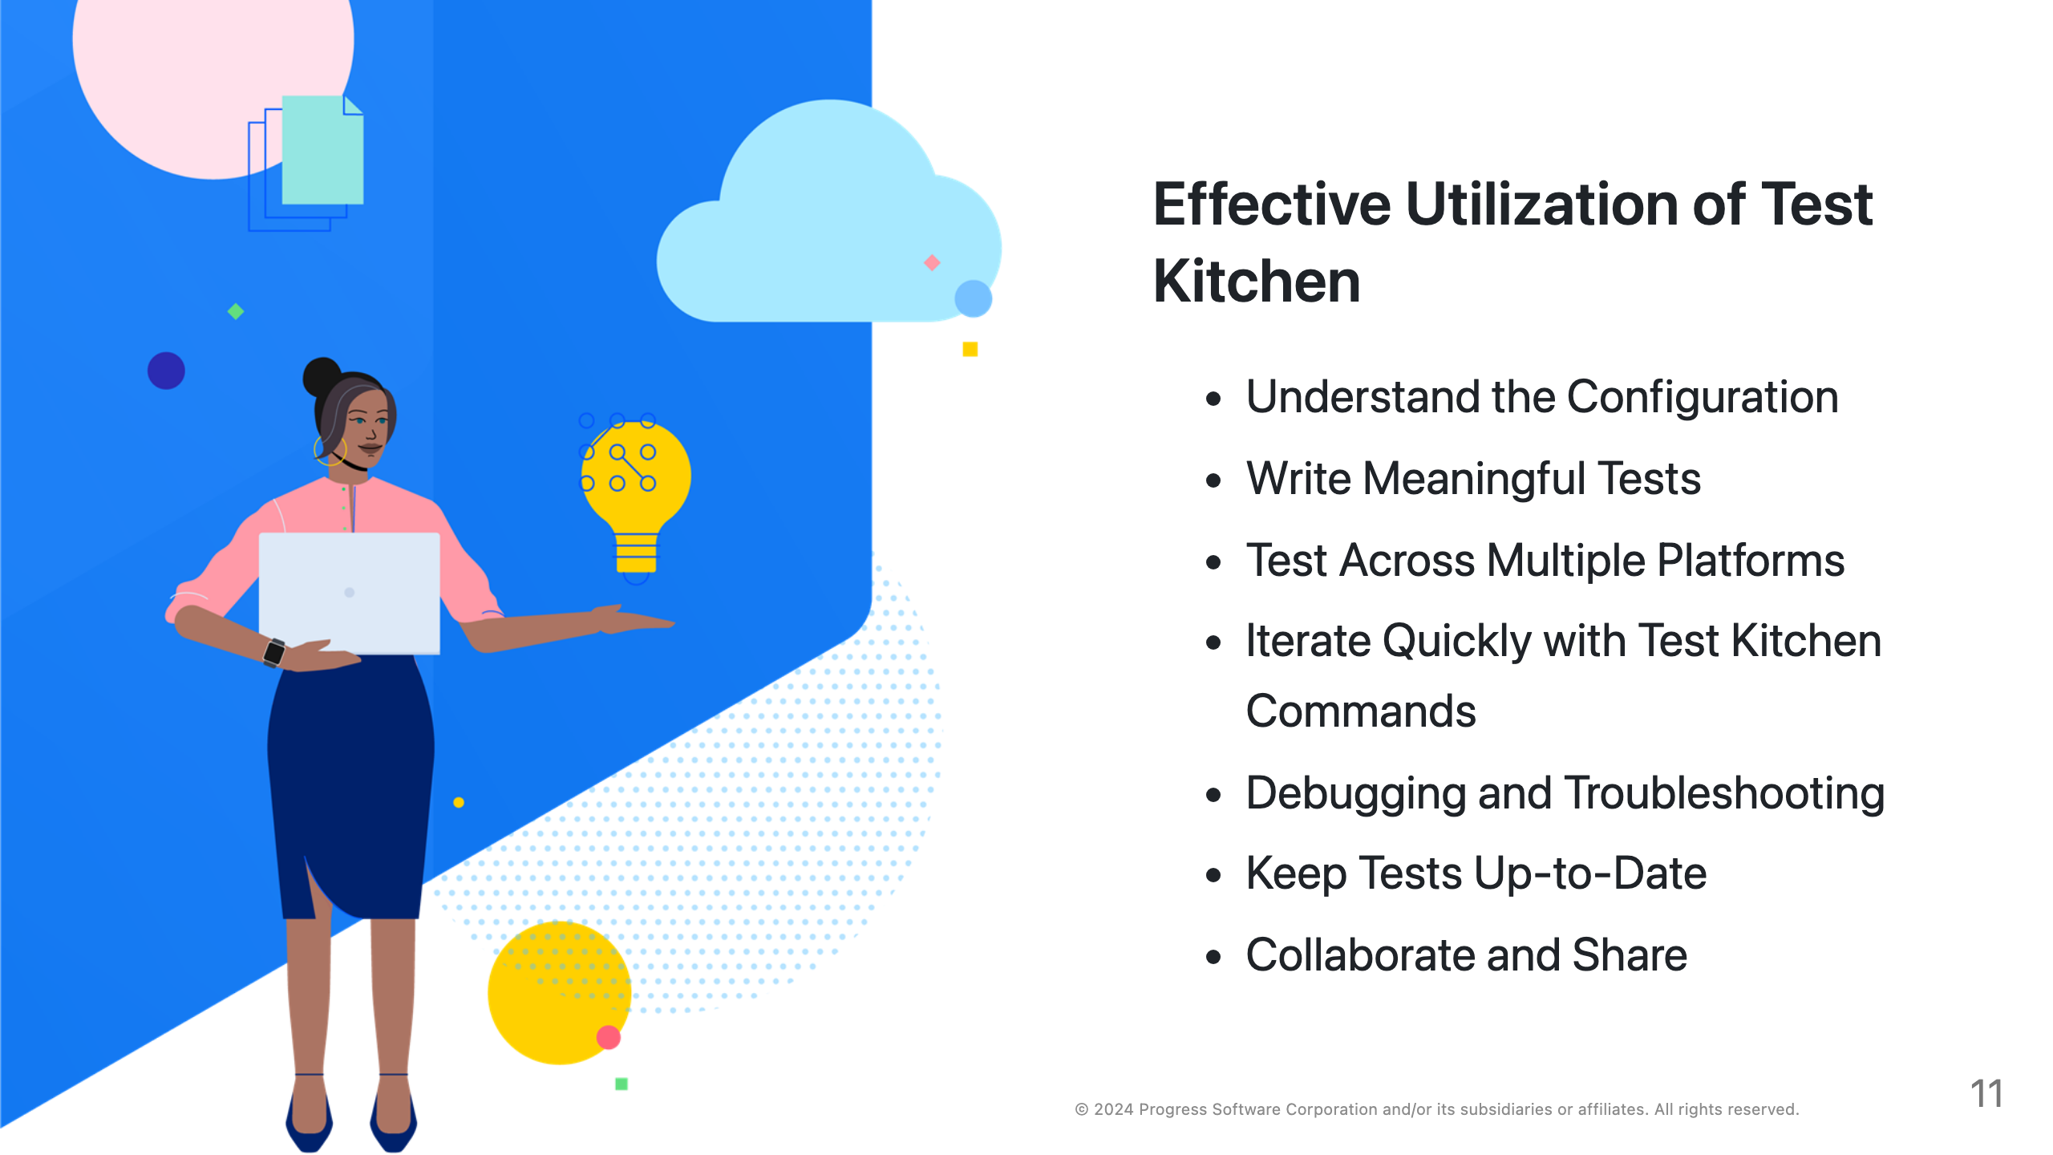

Slide 12
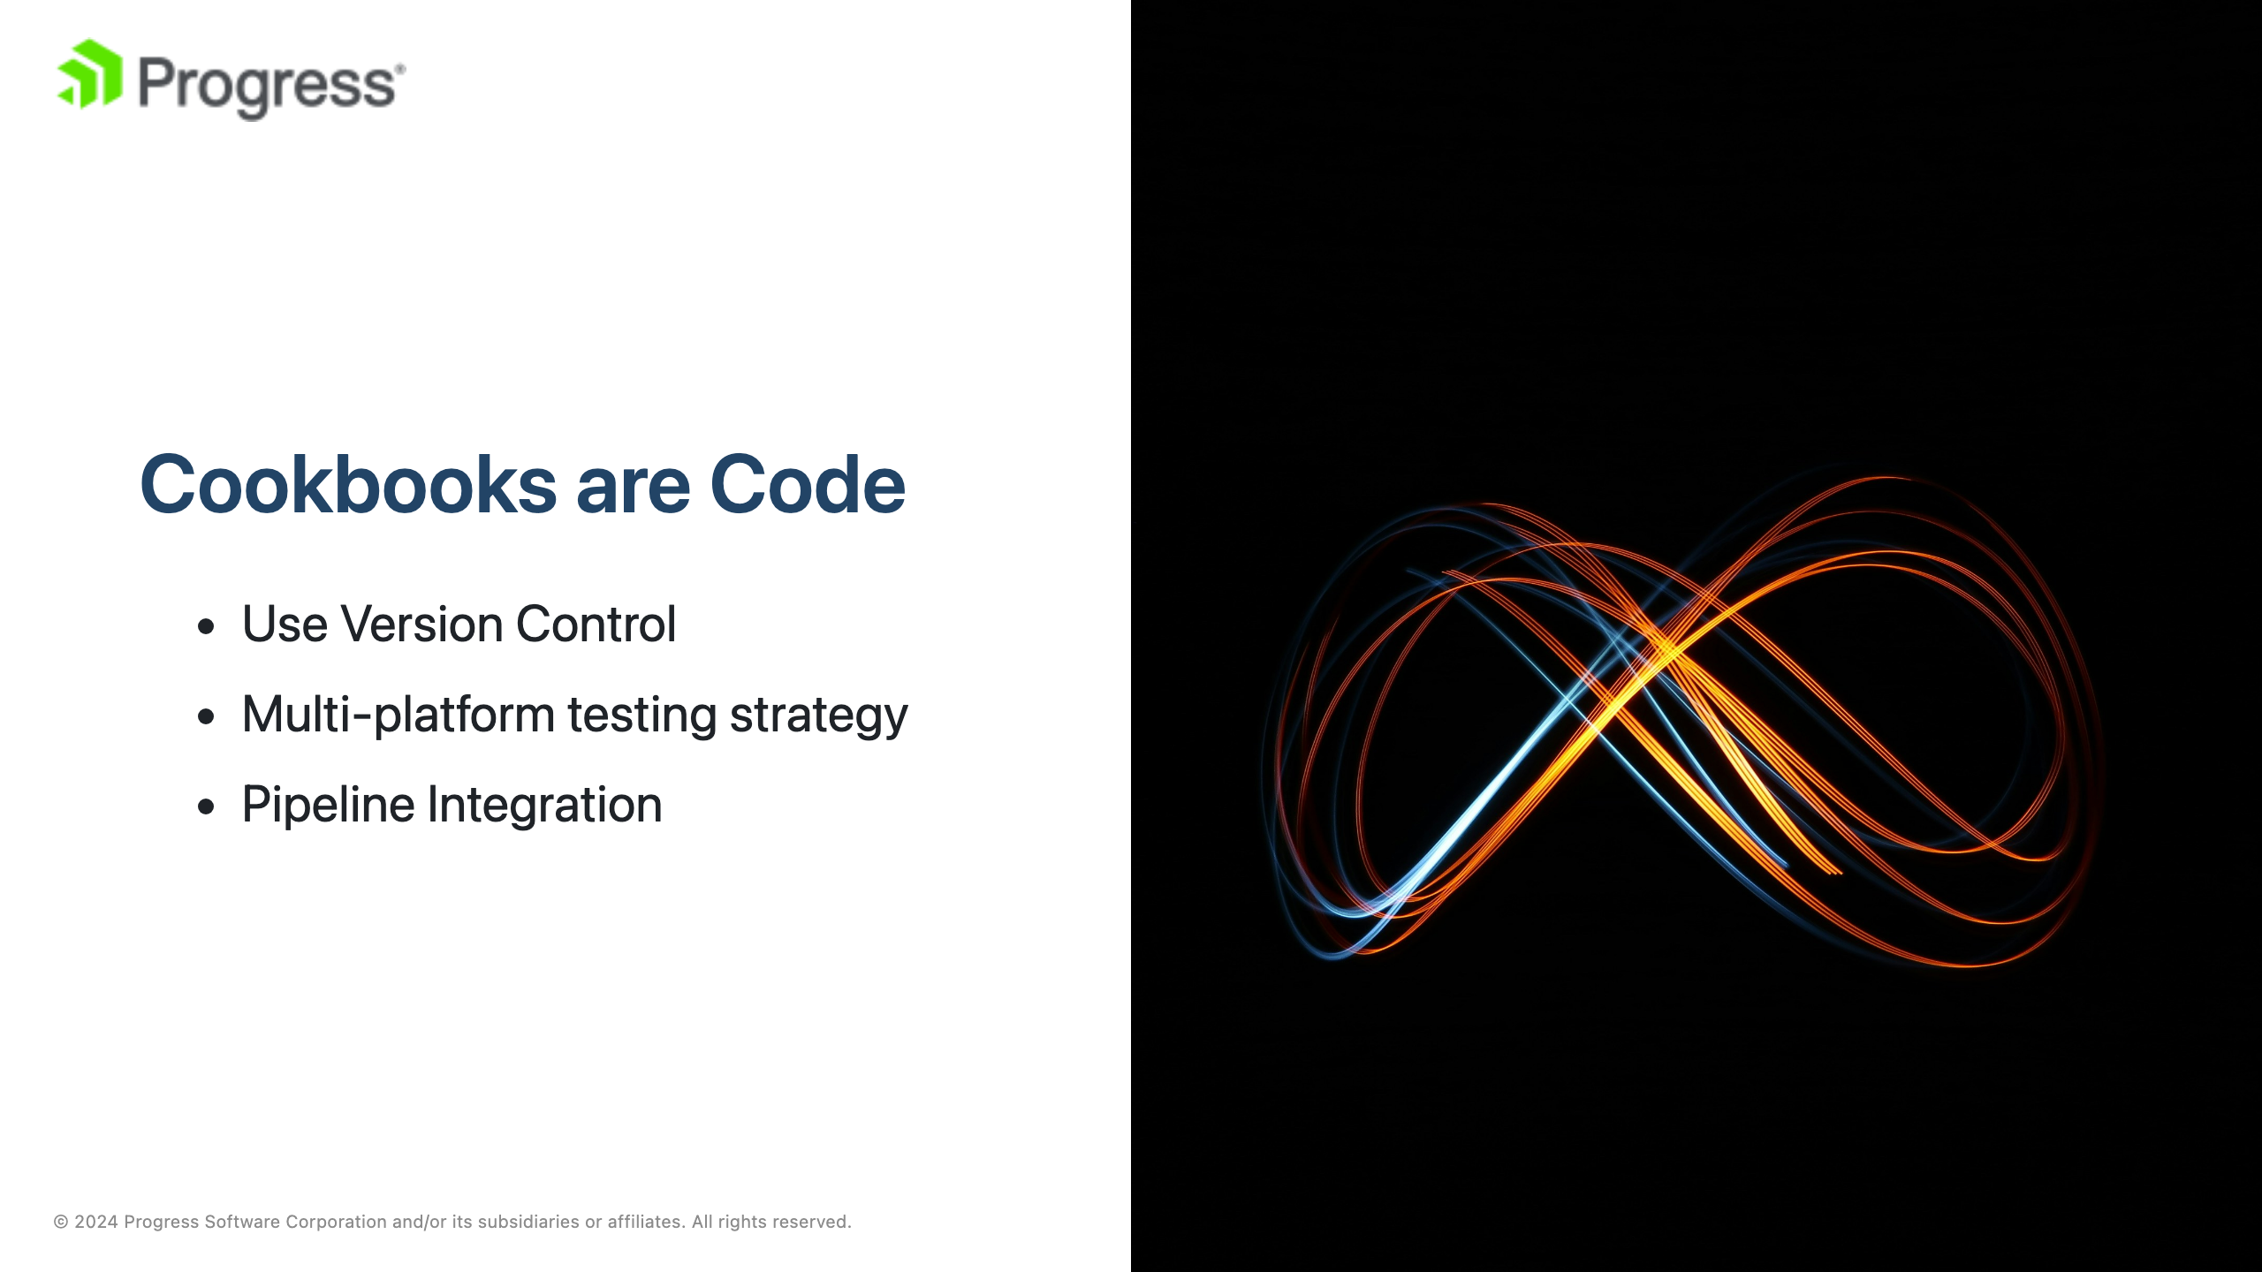
Notes:
image source: "https://unsplash.com/photos/a-blurry-photo-of-a-light-in-the-dark-ouwdw--XNzo" CI/CD

Slide 13
